Slide 1


NoSQL Data Management
MODULE 5-
Graph Databases and Connected Data Solutions
Department of Computer Science Engineering
School of Engineering

Slide 2
Graph Databases and Connected Data Solutions
1

Slide 3
Graph Databases and Connected Data Solutions
What Is a Graph Database?
Features
Consistency,
Transactions,
Availability,
Query Features,
Scaling,
Suitable Use Cases
Connected Data,
Routing, Dispatch, and Location-Based Services,
Recommendation Engines,
When Not to Use.
3

Slide 4
1. What is a Graph Database?
A graph database stores entities (nodes) and relationships (edges) as first-class citizens.
Nodes and edges can carry properties.
This structure makes traversals, shortest-path queries, multi-hop patterns, and pattern-matching cheap and expressive compared to relational or pure document models.
4

Slide 5
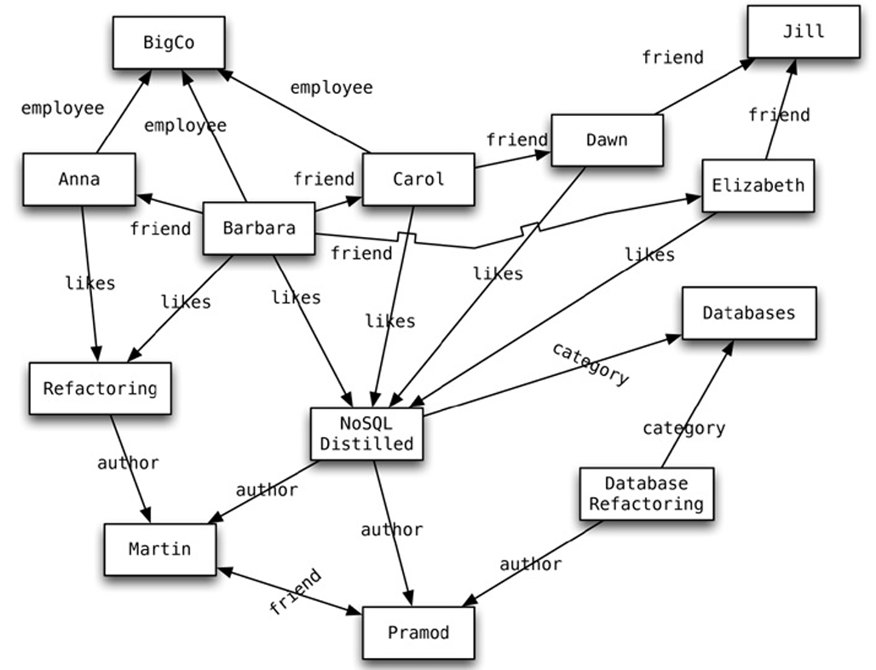
1. What is a Graph Database?
Graph Type:
This is a property graph, showing how people, companies, and books are connected by relationships such as friend, employee, likes, author, and category.
Main Entities (Nodes):
People: Anna, Barbara, Carol, Dawn, Elizabeth, Jill, Martin, Pramod
Company: BigCo
Books: Refactoring, NoSQL Distilled, Database Refactoring
Categories: Databases
5

Slide 6
1. What is a Graph Database?
Relationships (Edges):
employee: Connects people (Anna, Barbara) to company BigCo.
friend: Shows friendships between people (e.g., Barbara–Anna, Carol–Barbara, Dawn–Carol, Jill–Dawn, Martin–Pramod).
likes: Shows which books people like (e.g., Barbara likes Refactoring and NoSQL Distilled).
author: Connects authors to the books they wrote (e.g., Martin → Refactoring, Martin → NoSQL Distilled).
category: Connects books to their subject category (e.g., NoSQL Distilled → Databases).
6

Slide 7
1. What is a Graph Database?
Directionality: All arrows show directed relationships — e.g., “Anna → BigCo” means “Anna is an employee of BigCo”.
Example Connections:
Barbara is connected to many nodes: she is friends with Anna and Carol, likes several books, and works at BigCo.
Books like NoSQL Distilled have multiple incoming edges (liked by many people, authored by Martin and Pramod).
The Databases node connects multiple books by category.
7

Slide 8
1. What is a Graph Database?
Purpose of the Diagram: It demonstrates how a graph database (like Neo4j, ArangoDB, or MongoDB with $graphLookup) models real-world relationships — ideal for queries like:
“Who are Barbara’s friends’ favorite books?”
“Which authors wrote books in the ‘Databases’ category?”
“Who at BigCo likes books by Martin?”
Key Concept:
Each node and relationship can have properties (attributes like name, role, or date).
Graph databases excel at quickly traversing these relationships.
8

Slide 9
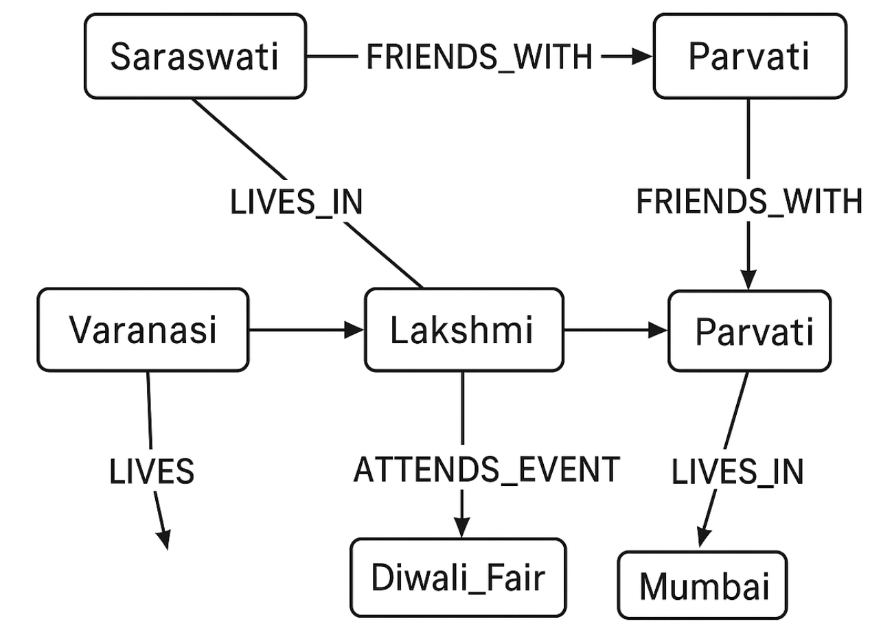
1. What is a Graph Database?
One more Example:
Nodes: Saraswati, Lakshmi, Parvati, Varanasi, Mumbai, Diwali_Fair
Edges/relations: FRIENDS_WITH, LIVES_IN, HOSTS_EVENT, ATTENDS_EVENT
9

Slide 10
2. Features
There are many graph databases available, such as Neo4J, Infinite Graph, OrientDB, or FlockDB (which is a special case: a graph database that only supports single-depth relationships or adjacency lists, where you cannot traverse more than one level deep for relationships).
For example, will take Neo4J as a representative of the graph database solutions to discuss how they work and how they can be used to solve application problems.
10

Slide 11
2. Features
In Neo4J, creating a graph is as simple as creating 2 nodes and then creating a relationship.
Let’s create two nodes, Martin and Pramod:
Node martin = graphDb.createNode();
martin.setProperty("name", "Martin");
Node pramod = graphDb.createNode();
pramod.setProperty("name", "Pramod");
11

Slide 12
2. Features
We have assigned the name property of the 2 nodes the values of Martin and Pramod.
Once we have more than one node, we can create a relationship:
martin.createRelationshipTo(pramod, FRIEND);
pramod.createRelationshipTo(martin, FRIEND);
12

Slide 13
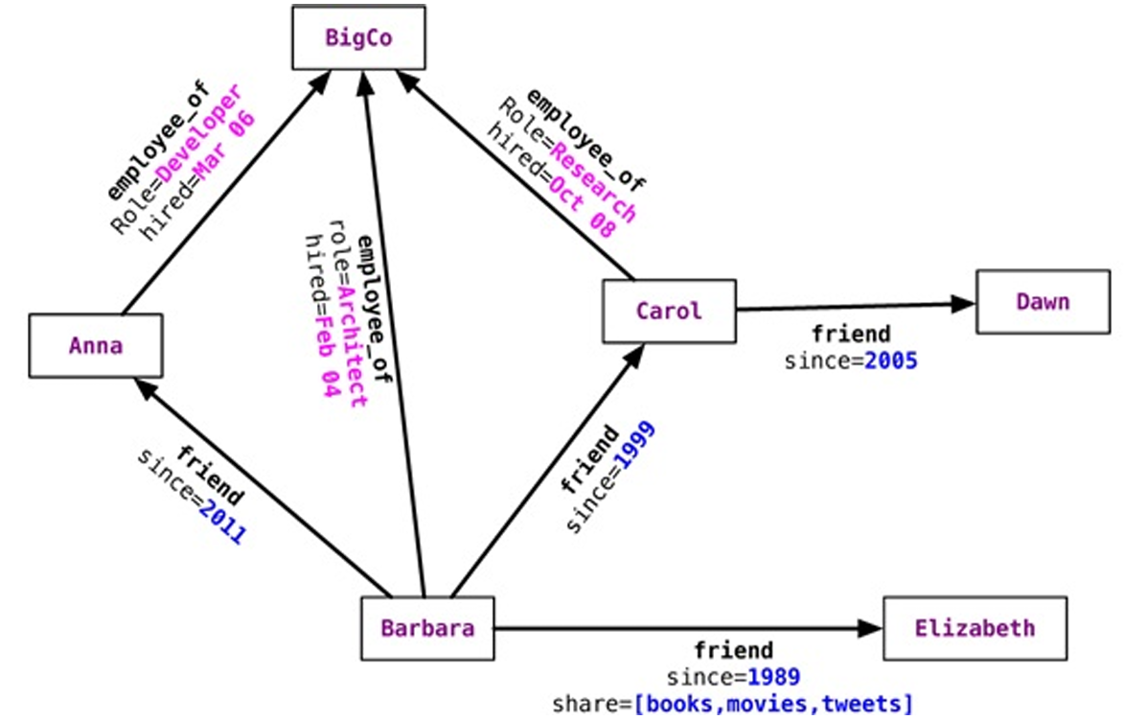
2. Features
We have to create relationship between the nodes in both directions, for the direction of the relationship matters
For example, a product node can be liked by user, but the product cannot like the user.
This directionality helps in designing a rich domain model
Nodes know about INCOMING and OUTGOING relationships that are traversable both ways
13

Slide 14
Key Features of Graph Databases
Schema Flexibility: Graph databases are schema-optional, allowing dynamic evolution of data models.
Relationship-Centric Storage: Relationships are stored as first-class citizens, allowing for fast traversals.
High Performance for Connected Queries: Queries that explore multi-level relationships are efficient.
ACID Transactions: Most modern graph databases (e.g., Neo4j) maintain full ACID properties.
Declarative Query Languages: Languages like Cypher (Neo4j) or Gremlin provide expressive ways to query data.
14

Slide 15
i. Consistency
Graph databases typically support strong consistency through ACID-compliant transactions:
Atomicity ensures all relationship updates occur completely or not at all.
Consistency ensures data adheres to graph integrity constraints.
Isolation prevents concurrent operations from interfering.
Durability guarantees data persistence even after failures.
However, distributed graph systems may trade off some consistency for performance (following CAP theorem principles).
15

Slide 16
i. Consistency
Since graph databases are operating on connected nodes, most graph database solutions usually do not support distributing the nodes on different servers.
There are some solutions, however, that support node distribution across a cluster of servers, such as Infinite Graph.
Within a single server, data is always consistent, especially in Neo4J which is fully ACID-compliant.
When running Neo4J in a cluster, a write to the master is eventually synchronized to the slaves, while slaves are always available for read.
Writes to slaves are allowed and are immediately synchronized to the master; other slaves will not be synchronized immediately, though—they will have to wait for the data to propagate from the master.
16

Slide 17
i. Consistency
Graph databases use connected data, so most of them can’t easily split or distribute nodes across multiple servers — everything usually stays on one machine.
Some graph databases, like InfiniteGraph, do support distributing nodes across several servers in a cluster.
When all data is on one server, it stays fully consistent, especially in systems like Neo4j, which follows ACID rules (safe and reliable transactions).
In a Neo4j cluster, when data is written to the main (master) server, it’s later copied (synchronized) to the other servers (slaves). The slave servers can still handle read requests anytime.
If a slave server accepts a write, that change is sent immediately to the master, but other slaves won’t get it right away — they’ll get the update after it spreads from the master.
17

Slide 18
i. Consistency
Graph databases keep data consistent by using transactions — every change follows strict rules.
They don’t allow broken or dangling relationships, meaning every connection must link two valid nodes.
The start node & end node of a relationship must always exist — you can’t connect to something that isn’t there.
A node can only be deleted if it has no relationships connected to it; otherwise, the delete action isn’t allowed.
18

Slide 19
ii. Transactions
Neo4j follows ACID rules, which means all data changes are done safely & consistently.
Before you make any changes (like updating nodes or adding new relationships), you must start a transaction — this ensures the operation is done properly.
If you try to make changes without a transaction, Neo4j will show an error called NotInTransactionException, meaning “you didn’t start a transaction.”
Reading data doesn’t need a transaction, so you can look up or query information freely without starting one.
19

Slide 20
ii. Transactions
Transactions in graph databases operate across nodes and relationships, ensuring referential integrity.
Example: Adding a new friendship edge between 2 users requires both nodes & the edge to be created atomically.
Graph databases like Neo4j and ArangoDB offer multi-document transactions, ensuring consistent state changes across complex operations.
20

Slide 21
ii. Transactions
Transactions in graph databases operate across nodes & relationships, ensuring referential integrity.
A transaction has to be marked as success, otherwise Neo4J assumes that it was a failure and rolls it back when finish is issued.
Setting success without issuing finish also does not commit the data to the database.
Transaction transaction = database.beginTx();
try {
Node node = database.createNode();
node.setProperty("name", "NoSQL Distilled");
node.setProperty("published", "2012");
transaction.success();
} finally {
transaction.finish();
}
This way of managing transactions has to be remembered when developing, as it differs from the standard way of doing transactions in an RDBMS
21

Slide 22
iii. Availability
Graph databases can be deployed in:
Single-node configurations for simplicity & strong consistency.
Clustered or distributed setups for high availability & fault tolerance.
Many provide replication and failover mechanisms to minimize downtime.
Distributed graph databases (e.g., Amazon Neptune, Dgraph) use replication & partitioning to ensure high availability while balancing latency.
22

Slide 23
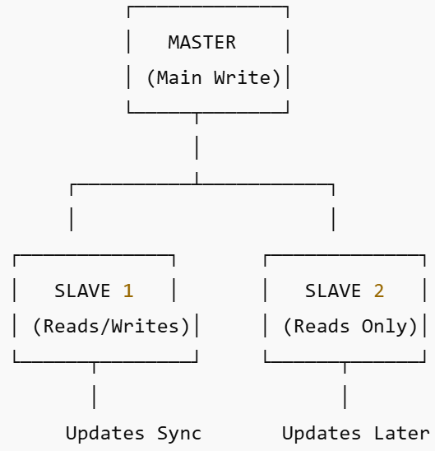
iii. Availability
In Neo4j, high availability is achieved by using replicated slave servers.
These slave servers can also handle write operations.
When a slave server receives a write, it sends the update to the master server.
The master server commits the change first, and then the slave server applies it.
Other slaves in the system will get the update later, once it spreads from the master.
Other graph databases, like InfiniteGraph and FlockDB, support distributed storage of nodes across multiple servers.
Slave writes → Master → Commit → Sync → Other Slaves.
23

Slide 24
iii. Availability
Neo4j uses Apache ZooKeeper to keep track of which server is the master and to record the last transaction IDs saved on each slave node.
When a server starts up, it contacts ZooKeeper to find out which server is currently the master.
If the new server is the first one to join the cluster, it becomes the master automatically.
If the current master goes down, ZooKeeper helps the cluster choose a new master from the remaining active servers.
This process ensures that the system always has a master available, providing high availability even during failures.
24

Slide 25
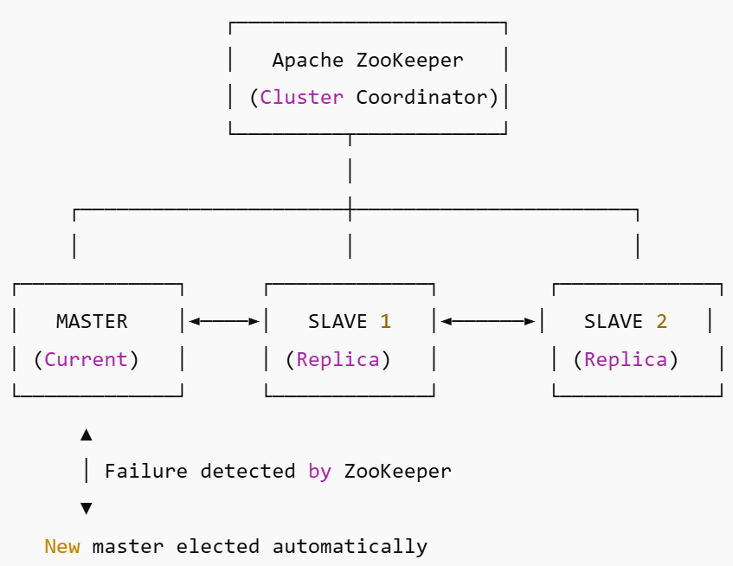
iii. Availability
ZooKeeper connects to all Neo4j nodes.
It monitors who’s the master.
If the master fails, ZooKeeper promotes another slave to become the new master.
25

Slide 26
iv. Query Features
Graph databases support specialized query capabilities such as:
Pattern Matching: Find nodes and relationships that match specific topological patterns.
Path Finding: Identify shortest paths or weighted routes between nodes.
Graph Algorithms: Centrality, community detection, clustering, and similarity scoring.
Declarative Query Languages:
Cypher (Neo4j) – human-readable, pattern-based syntax.
Gremlin (Apache TinkerPop) – traversal-based approach.
SPARQL (RDF/semantic graphs) – used for linked data queries.
26

Slide 27
iv. Query Features
Node properties can be indexed using the indexing service.
Relationships (edges) can also be indexed to find them by their values.
Indexes help locate the starting node for a graph traversal.
Nodes can be indexed while adding them or later by scanning all nodes.
The index is created using the IndexManager.
Index nodeIndex = graphDb.index().forNodes("nodes")
We are indexing the nodes for the name property.
Neo4J uses Lucene as its indexing service.
27

Slide 28
iv. Query Features
When new nodes are created, they can be added to the index.
Transaction transaction = graphDb.beginTx();
try {
Index nodeIndex = graphDb.index().forNodes("nodes");
nodeIndex.add(martin, "name", martin.getProperty("name"));
nodeIndex.add(pramod, "name", pramod.getProperty("name"));
transaction.success();
} finally {
transaction.finish();
}
28

Slide 29
iv. Query Features
Indexing and Searching Nodes
Nodes and relationships can be indexed using an indexing service.
Once indexed, they can be searched by property values (e.g., name = “Barbara”).
Example:
Node node = nodeIndex.get("name", "Barbara").getSingle();
This returns the node where the name property = “Barbara”.
After finding a node, we can get all its relationships.
allRelationships = martin.getRelationships();
29

Slide 30
iv. Query Features
Directional Relationships
Relationships can be incoming, outgoing, or both.
Example of getting only incoming relationships:
incomingRelations = martin.getRelationships(Direction.INCOMING);
You can also filter by relationship type (e.g., LIKES).
30

Slide 31
iv. Query Features
Query Example – Who Likes “NoSQL Distilled”
To find all people who like a book “NoSQL Distilled”:
Node nosqlDistilled = nodeIndex.get("name", "NoSQL Distilled").getSingle();
relationships = nosqlDistilled.getRelationships(INCOMING, LIKES);
for (Relationship relationship : relationships) {
likesNoSQLDistilled.add(relationship.getStartNode());
}
This finds all nodes that have an incoming ‘LIKES’ relationship to the book.
31

Slide 32
iv. Query Features
Traversing the Graph
Graph databases are powerful for deep traversals, not just direct links.
Traversals help find nodes multiple levels away (e.g., friends of friends).
Example:
Node barbara = nodeIndex.get("name", "Barbara").getSingle();
Traverser friendsTraverser = barbara.traverse(
Order.BREADTH_FIRST,
StopEvaluator.END_OF_GRAPH,
ReturnableEvaluator.ALL_BUT_START_NODE,
EdgeType.FRIEND,
Direction.OUTGOING
);
This finds all nodes connected to Barbara through FRIEND relationships — at any depth.
32

Slide 33
iv. Query Features
Finding Paths Between Nodes
You can find all paths or the shortest path between two nodes.
Example (Barbara → Jill):
Node barbara = nodeIndex.get("name", "Barbara").getSingle();
Node jill = nodeIndex.get("name", "Jill").getSingle();
PathFinder<Path> finder = GraphAlgoFactory.allPaths(
Traversal.expanderForTypes(FRIEND, Direction.OUTGOING),
MAX_DEPTH
);
Iterable<Path> paths = finder.findAllPaths(barbara, jill);
Used in social networks to show how users are connected.
33

Slide 34
iv. Query Features
Finding the Shortest Path
To get the shortest path between two nodes:
PathFinder<Path> finder = GraphAlgoFactory.shortestPath(
Traversal.expanderForTypes(FRIEND, Direction.OUTGOING), MAX_DEPTH
);
Iterable<Path> paths = finder.findAllPaths(barbara, jill);
Can also use algorithms like Dijkstra’s Algorithm for shortest or cheapest paths.
34

Slide 35
iv. Query Features
Introduction to Cypher Query Language
Cypher is Neo4j’s declarative query language for graphs.
Common structure:
START (beginning node)
MATCH (relationship pattern)
WHERE (filter conditions)
RETURN (what to return)
ORDER BY, SKIP, LIMIT (optional)
The query starts from a node (found by ID or index).
35

Slide 36
iv. Query Features
Basic Cypher Query Example
Find all nodes connected to Barbara:
START barbara = node:nodeIndex(name="Barbara")
MATCH (barbara)--(connected_node)
RETURN connected_node
Finds both incoming and outgoing relationships.
36

Slide 37
iv. Query Features
Direction-Specific Queries
Incoming relationships:
MATCH (barbara)<--(connected_node)
Outgoing relationships:
MATCH (barbara)-->(connected_node)
Can filter by relationship type using :RELATIONSHIP_TYPE.
37

Slide 38
iv. Query Features
Relationship Type Example
Find Barbara’s friends:
START barbara = node:nodeIndex(name="Barbara")
MATCH (barbara)-[:FRIEND]->(friend_node)
RETURN friend_node.name, friend_node.location
Finds all outgoing FRIEND relationships one level deep.
38

Slide 39
iv. Query Features
Multi-Level and Depth Queries
To find friends within up to 3 levels deep:
START barbara = node:nodeIndex(name="Barbara")
MATCH path = barbara-[:FRIEND*1..3]->end_node
RETURN barbara.name, end_node.name, length(path)
Returns all friends of Barbara within three levels and their path lengths
39

Slide 40
iv. Query Features
Query by Relationship Property
You can query based on relationship properties too.
START barbara = node:nodeIndex(name="Barbara")
MATCH (barbara)-[relation]->(related_node)
WHERE type(relation) = 'FRIEND' AND relation.share
RETURN related_node.name, relation.since
Filters based on relationship type and attributes
40

Slide 41
iv. Query Features
Neo4j allows:
Indexing nodes and relationships for quick search.
Traversing graphs at any depth.
Finding all or shortest paths between nodes.
Querying with Cypher for flexible graph analysis.
Ideal for social networks, recommendation engines, and network analysis.
41

Slide 42
V. Scaling in Graph Databases
Vertical Scaling: More RAM/CPU for deeper traversals.
Horizontal Scaling: Harder due to relationship dependencies.
Distributed Graphs: Partition large graphs into smaller subgraphs.
Caching and indexing improve performance.
42

Slide 43
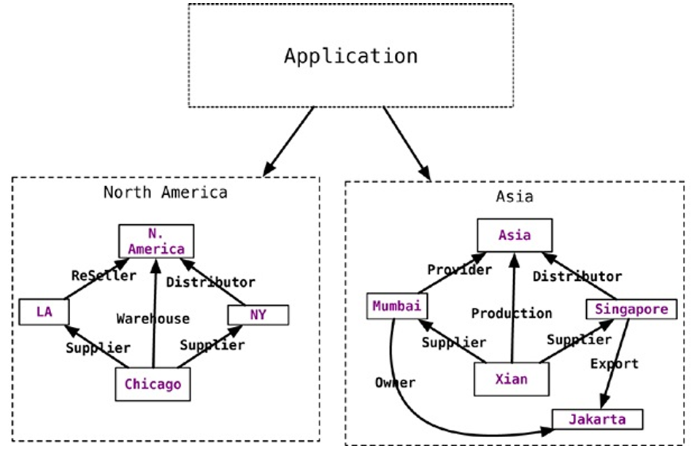
Scaling in Graph Databases
The diagram shows how an application connects and manages regional networks in North America and Asia.
Each region has its own nodes (cities) & relationships (business roles) connecting them.
The Application oversees both regional networks.
Each region operates independently but follows similar relationship structures — like distributors, suppliers, and providers.
This demonstrates how graph databases can model real-world connected data, such as global supply chains.
43

Slide 44
3. Suitable Use Cases
Use Case | Description | Example
Social Networks | Model people and relationships | Facebook friends graph
Recommendation Engines | Find similarities between users/items | “People also bought…”
Routing & Logistics | Shortest paths, delivery optimization | Uber route matching
Fraud Detection | Spot hidden connections between accounts | Linked financial fraud
Knowledge Graphs | Semantic search and reasoning | Google Knowledge Graph
44

Slide 45
Connected Data Solutions
Graph databases enable connected data insights across systems:
Integrate social, spatial, and transactional data.
Enables real-time decision-making through relationships.
Examples:
Routing & Dispatch:
Model cities, roads, and traffic for pathfinding.
Used in ride-sharing, logistics, delivery tracking. (Visual: city road network graph)
Recommendation Systems:
Link users, preferences, and behaviors.
Suggest similar users or products. (Visual: User → “LIKES” → Product → “SIMILAR_TO” → Product)
45

Slide 46
4. When Not to Use Graph Databases
Avoid graph databases when:
Data is not highly connected (simple tabular data fits better).
Workloads are heavy on aggregation or analytics (use OLAP/columnar DB).
Need very high write throughput (key-value DBs perform better).
Global joins over distributed graphs become inefficient.
46

Slide 47


